Slide 1
Delivering community impact through a coordinated VCS response
The Sheffield Hub Network story
Maddy Desforges (Voluntary Action Sheffield), David Bussue (SACHMA), Michael Ng (Sheffield Alcohol Support Service/Project 6)

Slide 2
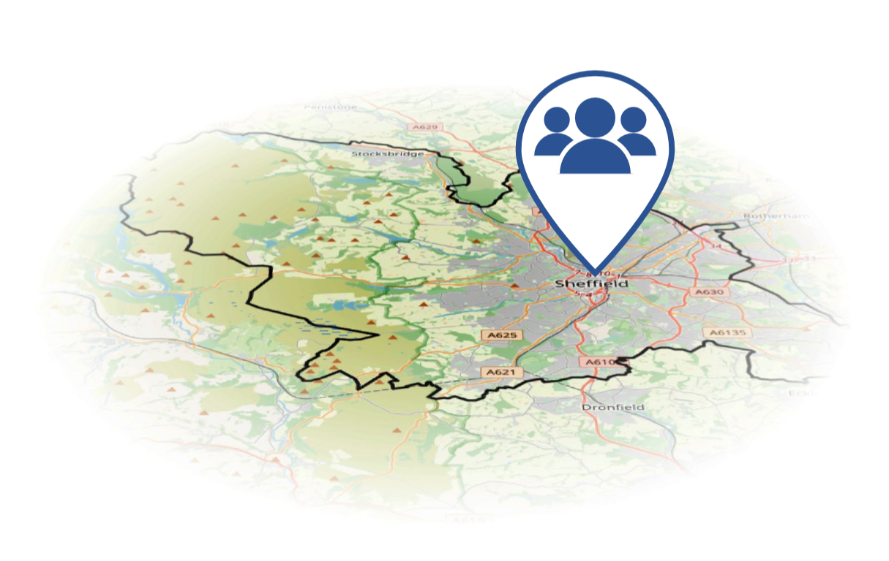
“The VCS in Sheffield responded swiftly & effectively to the Covid-19 pandemic, with a map of support available online by 20 March, and the start of the hub network in place by the same time”

Slide 3
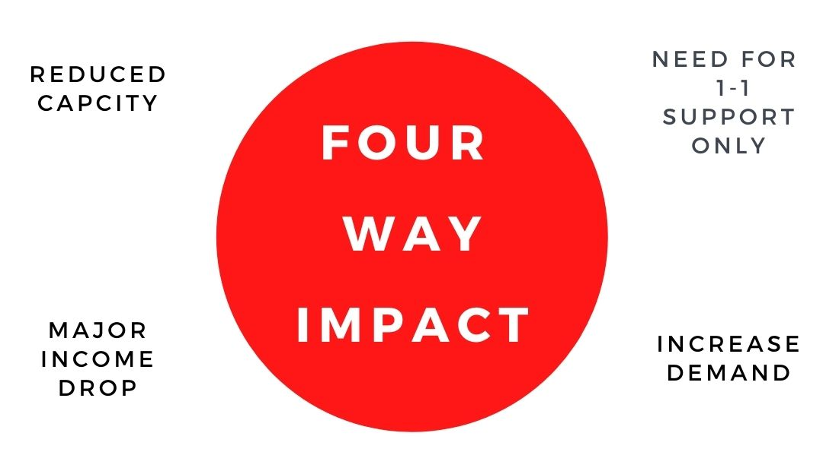
“VCS organisations have seen a four-way impact on their capacity”

Slide 4
We urgently need to consider the relationship the city has with it’s VCS. In particular we need to think about:
Nurturing the VCS
A strategic relationship with the VCS
Recognising the trusted status of VCS organisations
Reducing inequalities
A shared approach to Sheffield democracy

