Slide 1
Eased Transitions?
Young Volunteers’ Perceptions of What They Gain From Volunteering in Areas of Socio-Economic Deprivation
James Davies
E: james.davies@strath.ac.uk
T: @james925

Slide 2
Volunteering by deprivation
Adapted from Scottish Household Survey

Slide 3
Scottish Government interventions

Slide 4
Volunteering outcomes
Movement into “positive destinations”
Difficult to establish causality
Wellbeing and “soft” outcomes
Issue of selection bias in studies

Slide 5
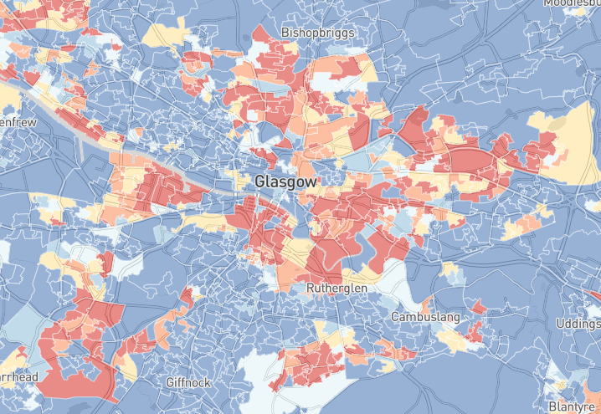
Methodology
Taken from https://jamestrimble.github.io/imdmaps/simd2016/

Slide 6
Gained from volunteering
3. Challenging social divisions
1. Social interaction
2. Self-esteem + confidence

Slide 7
Social interaction
Round ma bit there’s naebody that comes out, we all like, when we were younger all we did was come out but now that we’ve grew up, like, naebody does, so this is where I get, like I kinda stopped coming to [youth charity] and then because like naebody started to come out I got bored, I just thought, “I’ll come to [youth charity] again
Megan, 13, volunteer

Slide 8
Self-esteem and confidence
Ever since I like started volunteering it’s like completely changed your confidence and stuff it’s, never used to feel confident and stuff and then when you start getting, you get flung into different places and stuff then you just get to know new people and stuff
Donna, 15, volunteer

Slide 9
Challenging social divisions
All the things like, wherever they stay, or wha’ever team they support, ‘n what religion they are and all that […] so you could be opposites wi’ people and you wouldnae be able to speak to them because ‘ae wherever they came fae or stuff like that […] [At the youth charity] it doesnae matter what team ye support or what, what you believe in, like you all just get treated equally […] And it’s just a way for yous all to socialise
Niamh, 14, volunteer

Slide 10
Implications…
Significance for transitions?
Social skills
Confidence
Broadened spatial movement
Significance for wellbeing?
Positive relationships
Self-esteem
A “magic bullet”?

